Slide 1
CSD1401 Software Engineering Project 1
States
Concept
Input

Slide 2

Concept

Slide 3
Metaphor
“state of affairs”
“State of mind”
“State of emergency”
Condition of something with regards to its main attributes

Slide 4
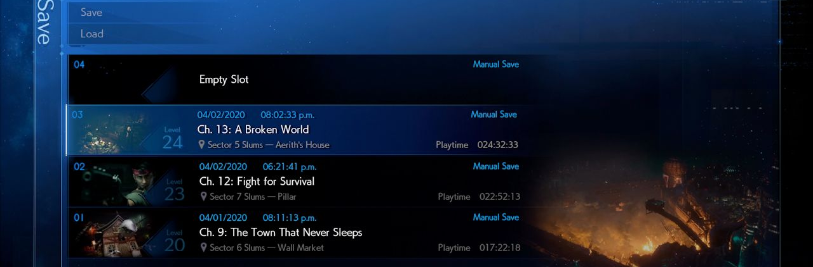
States
Saved games

Slide 5
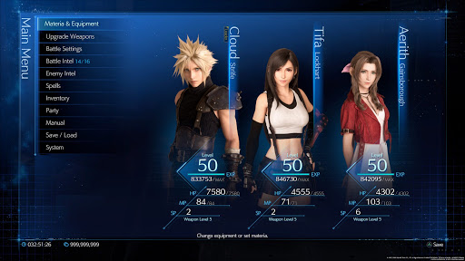
States
Current state of the game

Slide 6
States
While the game is running
States stored in variables (int, float, etc)
When the game is off
States stored in saved files (.txt, .json, .xml, etc)

Slide 7
States
char isOn = 0;
char PressSwitch()
{
if(isOn)
{
isOn = 0;
}
else
{
isOn = 1;
}
return isOn;
}
char PressSwitch()
{
isOn = !isOn;
return isOn;
}
On and off states (Binary)
Movable/immovable
Alive/dead
Win/lose
True/false

Slide 8
States
Discrete states
Stages : Level 1/ Level2/ Level3
AI: Patrolling/ chasing/ attacking
enum EnemyState
{
STATE_PATROLLING,
STATE_CHASING,
STATE_ATTACKING
};
enum EnemyState current_state = STATE_ATTACKING;
if(current_state == STATE_ATTACKING)
{
current_state = STATE_PATROLLING;
}

Slide 9
States
quantity states
Health
Experience level
money
/*Attacker state*/
float attack_power = 10.0f;
float attack_buff = 0.1f;
/*Player state*/
float health = 100.0f;
float defense = 5.0f;
float damage = CalculateDamage(attack_power, attack_buff, defense);
/*Player state updated with damage taken*/
health -= damage;

Slide 10
States
Game states
Different information displayed
Different interpretation of input

Slide 11

States
This concept can be applied to any system or structure
What examples can you think of?

Slide 12
States
CSG
Main Menu, Car select states
Car states
Selected car state
Game Of Life
LIVE or DEAD state of each cell

Slide 13

Input

Slide 14

Source
Including and not limited to
Keyboard
Mouse
Gamepad
Microphone
Camera
Data stream
Inertia Measurement Unit
GPS
Etc.

Slide 15
Operating System (OS)
Interacts with these inputs
Has memory allocated to deal with the inputs
Has API for developers to interact through software

Slide 16
Pressing Input
Event Type | Previous Frame | Current Frame
Triggered | Off | On
Pressed / Down | On | On
Released / Up | On | Off
The hardware sends a signal if there is an input, otherwise might not send any signals
Input system records the signal (if any) each frame, and does the comparison between past and current frame to tell the user the “Event Type”

Slide 17
CPROCESSING
https://github.com/DigiPen-Faculty/CProcessing/wiki/Input

